Slide 1
Happiness and Human Potential
Dan Baker, Ph.D.

Slide 2
Private and Confidential
All materials constituting this presentation (the “Materials”) are confidential and proprietary property solely owned and copyrighted. The Materials are intended for use only by the individual or entity that receives the Materials directly and such individuals associated with the Recipient on a “need to know” basis. The Materials shall not be copied, modified or otherwise reproduced by Recipient without the express written permission.

Slide 3
Happiness and Human Potential
“A happy company is an organization in which individuals at all levels of authority exhibit a diversity of strengths, constructively work together toward a common goal, find significant meaning and satisfaction in producing and providing high-quality products and services for profit, and through those products and services make a positive difference in the lives of others.”
    Dan Baker Ph.D.

Slide 4
Humans realize their potential because they are happy, passionate, focused and dedicated first…
People and organizations who lead from negativity are reactive and see only problems, the possibilities elude them.
‘‘Obviously, this objective is not achieved with the prevailing four D’s approach (damage, disease, disorder, and dysfunction) that focuses on preventing poor performance, low motivation, unwell-being, ill-health, and disengagement.”
  Arnold B. Bakker, Dean of the Institute of Psychology, Erasmus University, Rotterdam, Journal of Organizational Behavior, J. Organiz. Behav. 29, 147–154 (2008), Published online in Wiley InterScience

Slide 5

Proactive Positivity
People who are proactive and lead with positive emotions see possibilities all around.
From an organizational development perspective this approach leads to a ratio of positive to negative (P/N) events.
  In high performance teams the P/N = 5.6
  In medium performing teams the P/N = 1.9
  In low performance teams the P/N = .36
    Source: Losada and Heaply

Slide 6
The desire to be happy is deeply embedded within human beings across all generations and throughout all cultures…
The organizations that create a culture that reinforces happiness will attract the best and brightest talent, i.e. those with the greatest potential!
“Colombia, the only risk is wanting to stay.”

Slide 7
The Importance of Happiness…
  Better Health
  Better Relationships
  Enhanced Creativity/Innovation, Intuition and Productivity
  Higher Overall Quality of Life
  What do all the factors above mean for business?
    The flourishing organization
    The state of “Flow”

Slide 8
Why the Scientific Study of Happiness?
The advent of psychology as a problem solving discipline in the 1920’s
The advent of positive psychology in 1999
The goal is to clearly understand all the factors and dynamics that make up success so success can be replicated.

Slide 9
What is Positive Psychology?
The scientific study of character, virtues, and strengths/talents
The study of what’s right with human beings and their organizations
How much time, energy and resources do organizations focus on addressing and fixing problems vs. transforming possibilities into reality?
William Hall, Ph.D.

Slide 10
Why Do Humans Have Emotions?
Survival – Fear
Bonding – Love and Affection
Inspiration – Appreciation
Emotions are energy
  Positive (+) emotions adds energy
  Negative (-) emotions take away energy

Slide 11
The Nature of Happiness…
It is not a mood and more than an emotion
It is a way of being. Happiness comes from living fully everyday engaged in meaning and living life purposefully.
The climate and culture of an organization is either more positive or more negative. This is a function of awareness and intention of its leadership and its employees.

Slide 12
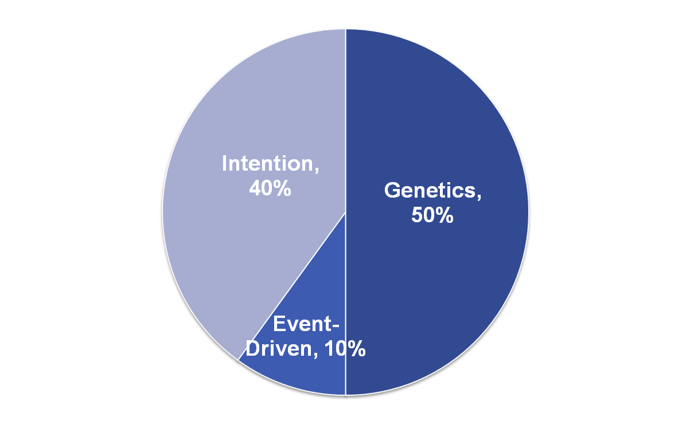
The Origins of Happiness….

Slide 13
Happiness Tools…
Appreciation
The Power of Choice
Personal Power
Leading With Talent
The Power of Language and Stories
Multidimensional Living and Work/Life Balance

Slide 14
Given the significant portion of your adult life that will be engaged in work, where would you choose to invest it?
  Working in Chernobyl?
  Or working in a flourishing environment where there is a positively compelling desire to develop human potential to the fullest extent possible?

Slide 15
Happiness and Human Potential
" We all have possibilities we don't know about. We can do things we don't even dream we can do.”
  Dale Carnegie
“Hiring people who are capable of doing the job, want to do the job and would be manageable if hired should result in happy employees whose work contributes to customer satisfaction.”
  Dick Moore

Slide 16
http://danbakerconsulting.com/

